Slide 1


The Relationship Between Attendance and Unemployment & COVID-19 cases in TEXAS
Ye Seo Park

Slide 2

International Student. 🇰🇷
Curious about human behavior 🤔
During the COVID pandemic, I was a Master’s Student and couldn’t attend the classes due to the COVID infection. 🦠
COVID REALLY affected my life and even my research. (eg. languish) 🫠
I am …

Slide 3
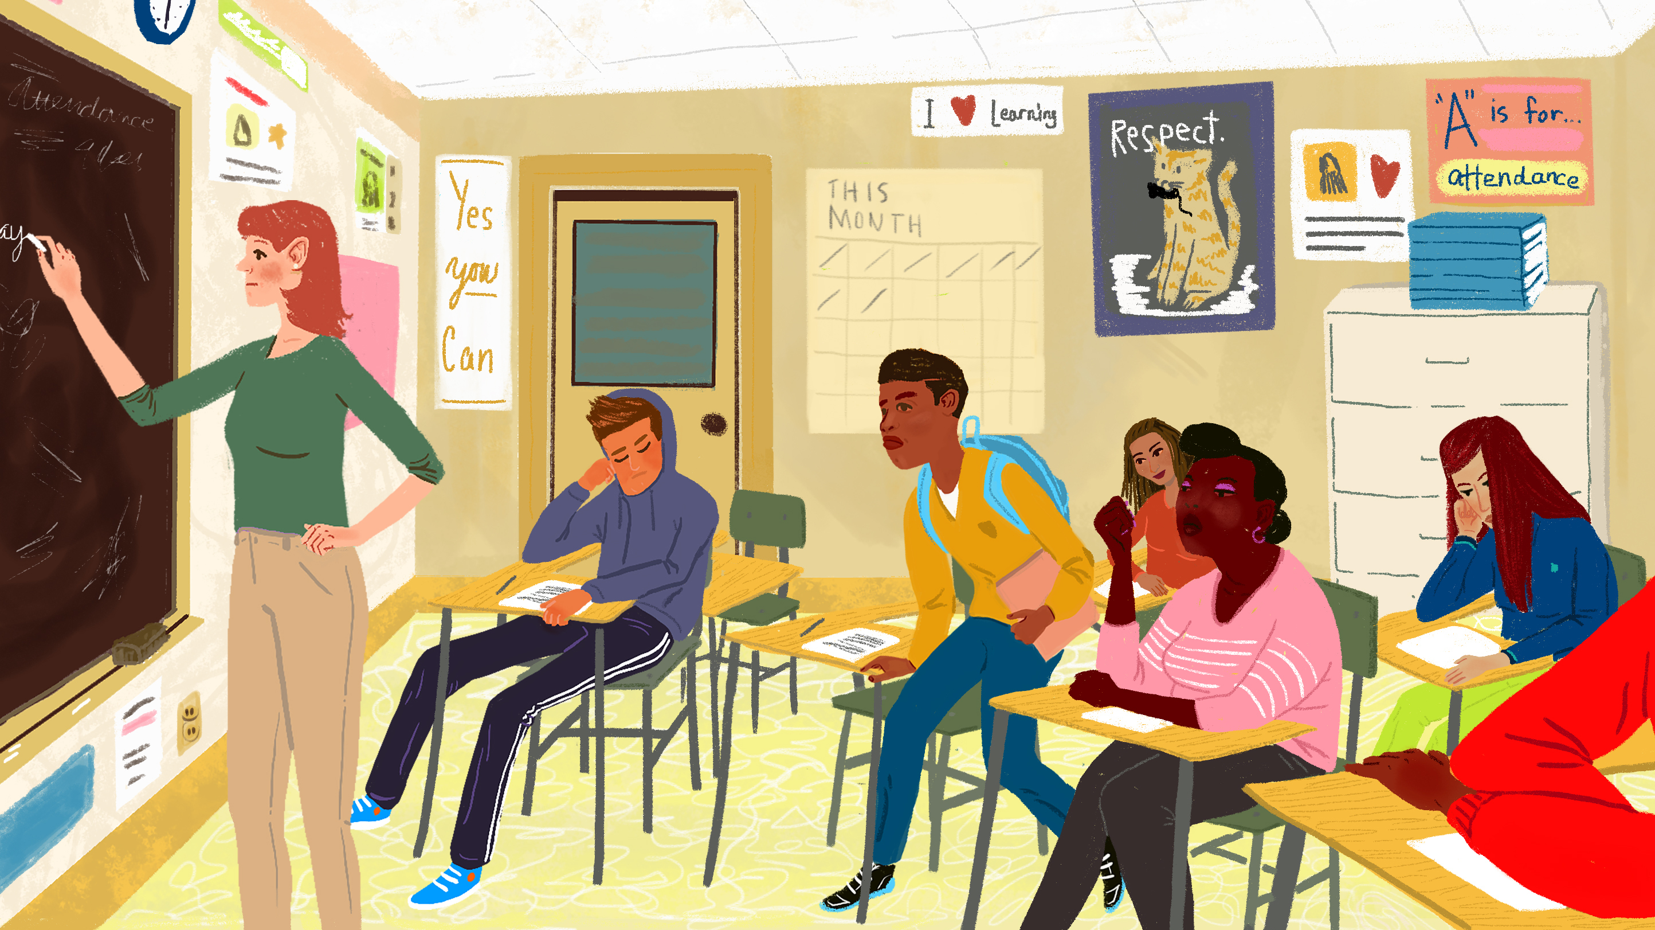
Attendance during the COVID Pandemic
How many students would attend ?
How many parents won’t let children go to school ?
How attendance affect unemployment?
How COVID make life change?

Slide 4
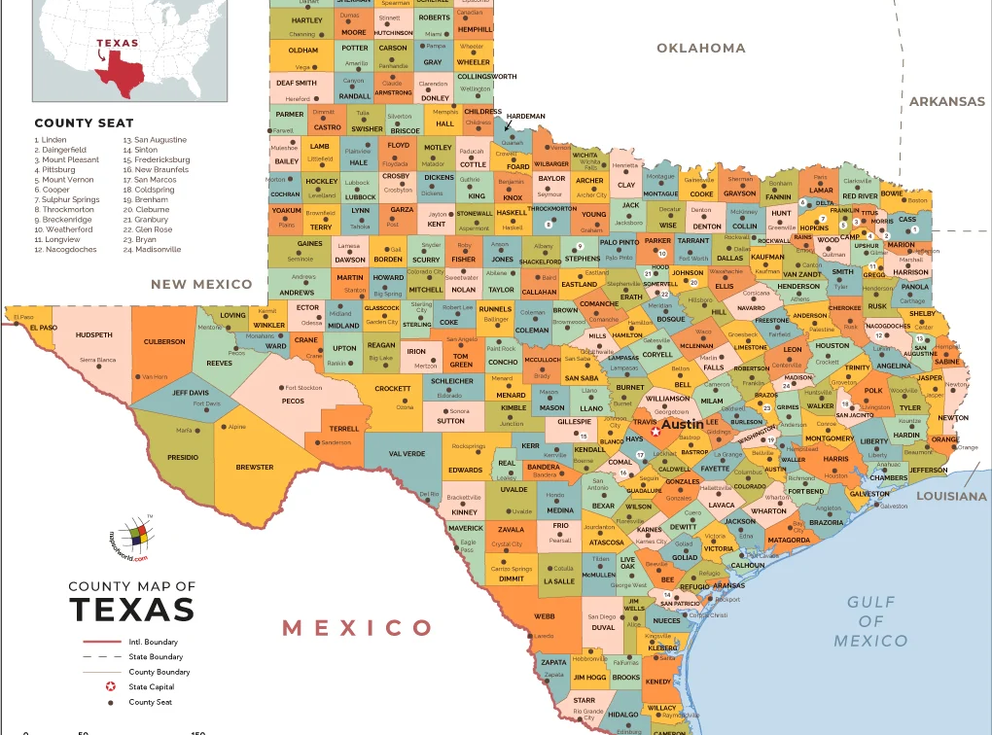
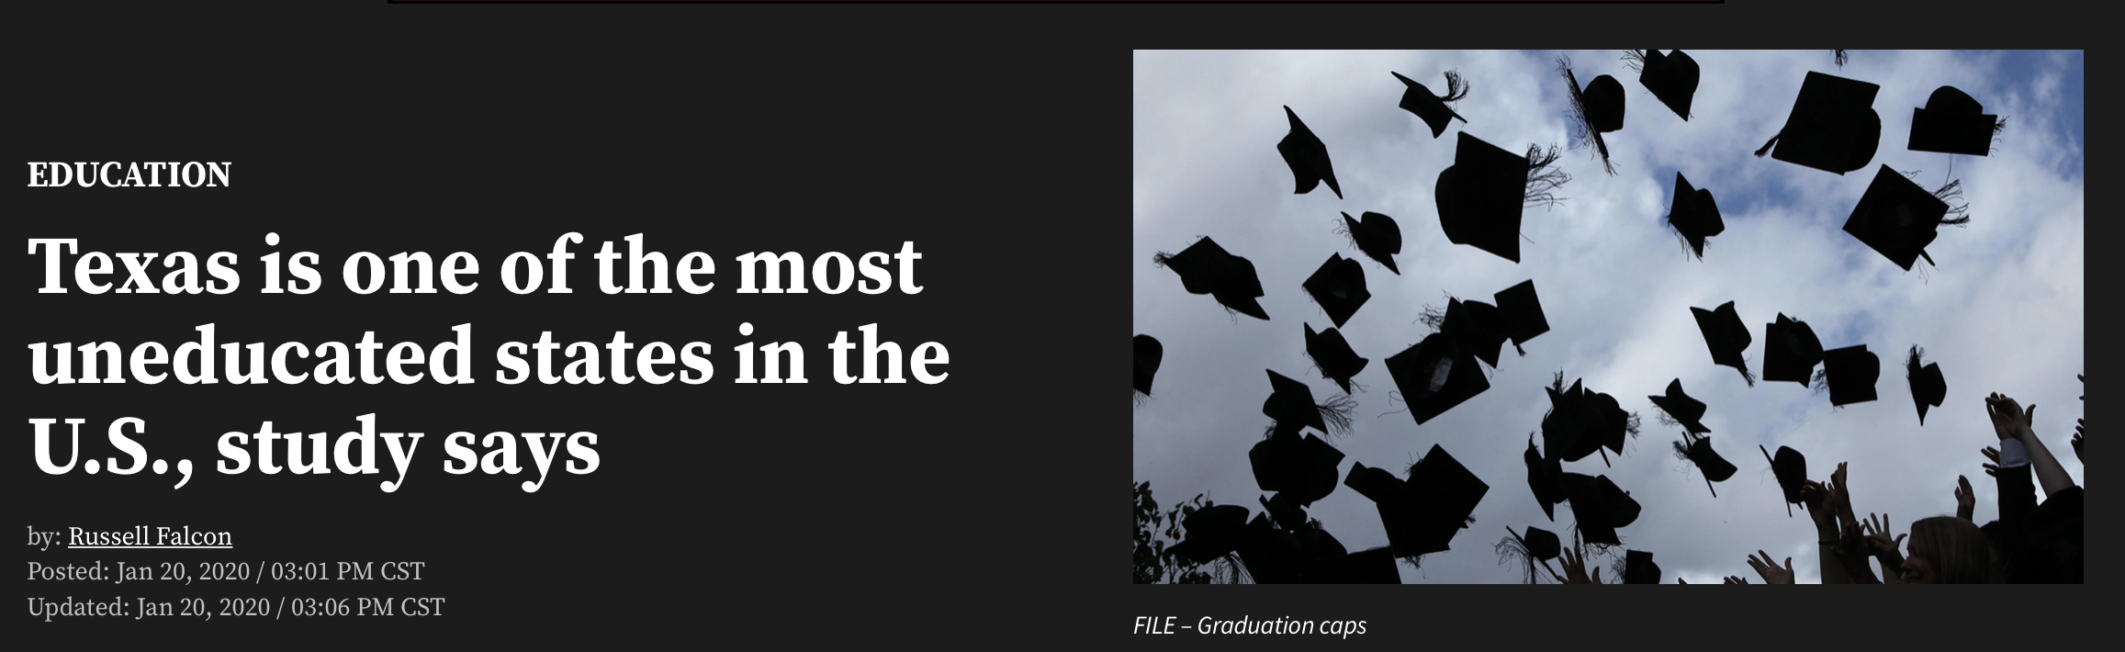
No. 39

Slide 5
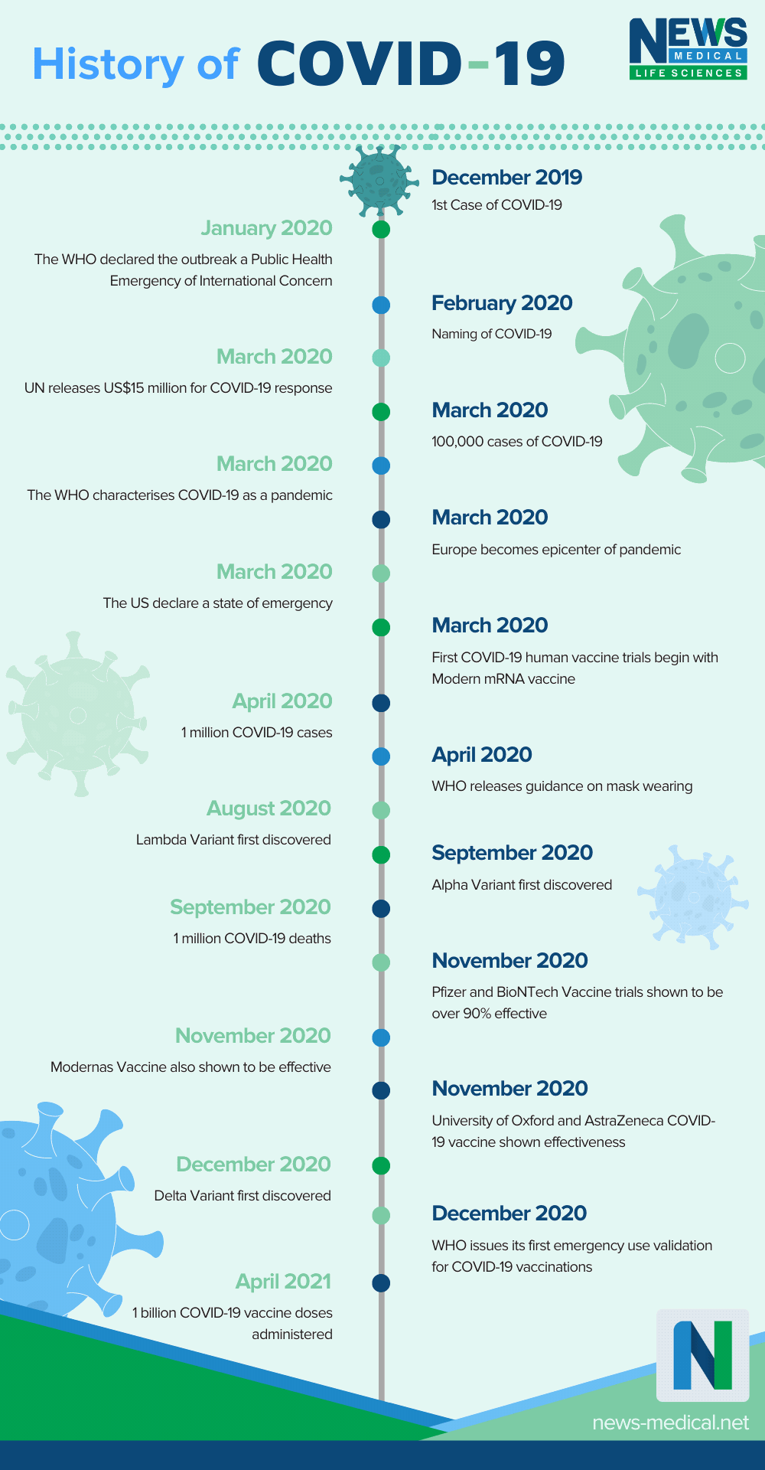
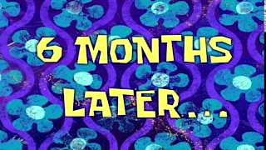
My Prediction
COVID
Attendance
Unemployment

Slide 6
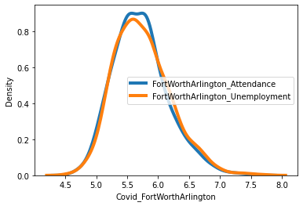
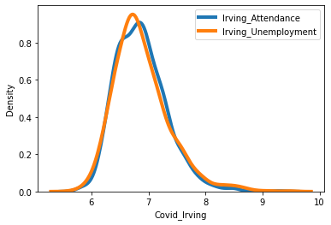
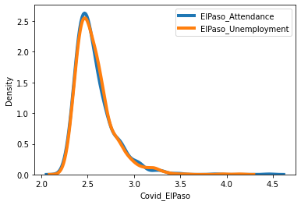
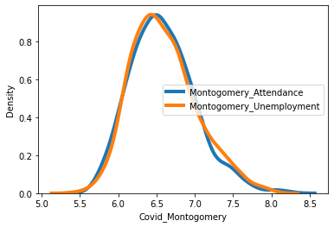
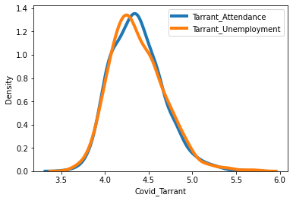
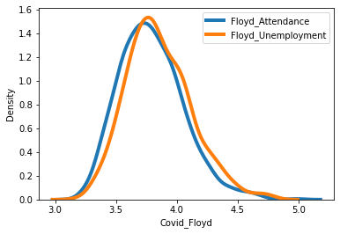
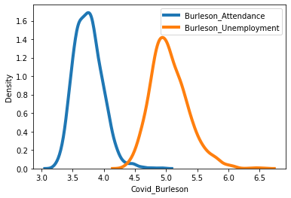
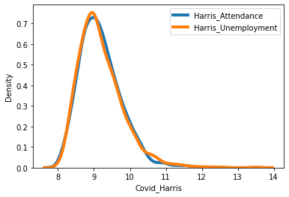
2 t- test
Almost same distributions of the attendance and the unemployment!
Burleson has different distribution of the attendance and the unemployment.
Harris has the highest distribution range and the lowest density.

Slide 7
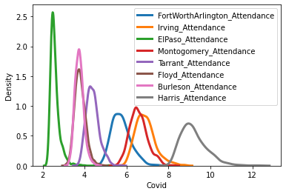
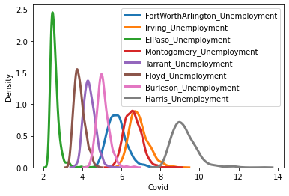
2 t- test with various counties

Slide 8
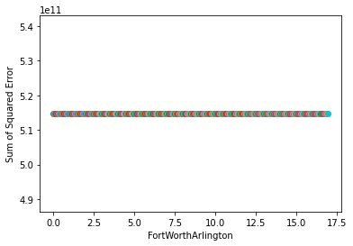
Linear regression
np.mean(attendance percentage)
County | Intercept (Covid) | Slope 1 (Attendance) | Slope 2 (Unemployment) | Slope 3 (Relationship)
Fort Worth Arlington | 227095 | 12857 | -21230 | -749
Irving | 232965 | -14070 | -20773 | 1263
El Paso | 134259 | -45238 | -12916 | 5961
Montogomery | 185260 | 85672 | -15775 | -12353
Tarrant | 148950 | 32575 | -13953 | -5300
Floyd | 18155 | 6982 | -2383 | -1354
Burleson | 1104 | -8 | -122 | 2
Harris | 228987 | 98579 | -9467 | -12265
“Only one form with the straight horizontal line”

Slide 9
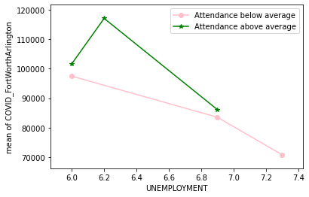
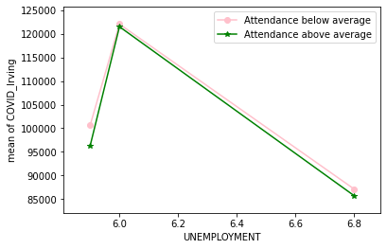
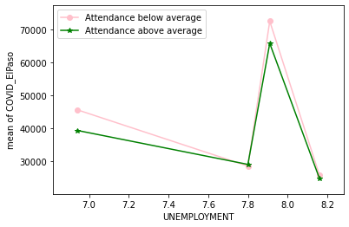
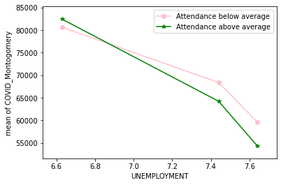
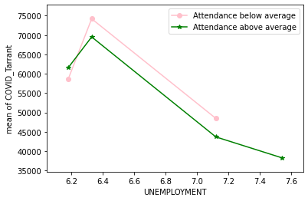
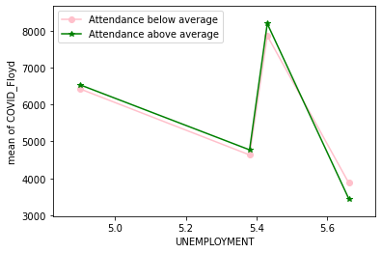
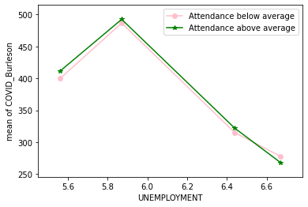
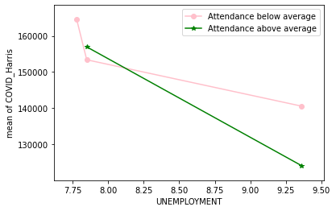
Relationship
According to the prediction, low attendance should be positioned in high unemployment range.
Most unemployment rates decreased, and most attendance percentages increased as covid cases are increasing.

Slide 10
Conclusion
My Prediction with the relationship of Covid ~ Attendance ~ Unemployment was wrong from the relationship plot results.
Attendance has NO relevant to the unemployment during the COVID pandemic.
In most counties, most unemployment rate decreased at the highest COVID cases, the government may start the employment support from that period.

Slide 11
Limitations & Next Step
Due to the mandatory attendance, finding the attendance data sufficiently is not accessible and most student might attend the classes despite COVID.
Based on findings, I want to analyze the student behavior on the attendance during the pandemic and the consequence of school life such as grades or interpersonal relationship and the influence of school life on the home environment.

Slide 12
Thank you :)

